Slide 1
IT694 Computer Networks
Week5-Transport layer-I

Slide 2
Write a simple protocol for client and server for exchanging a single message

Slide 3
What if the client has multiple messages to send?

Slide 4
How does the client get to know if earlier message was received at the server?
How does the server get to know if earlier message was received at the server?

Slide 5
TCP: overview RFCs: 793,1122, 2018, 5681, 7323
point-to-point:
one sender, one receiver
reliable, in-order byte steam:
no “message boundaries"
full duplex data:
bi-directional data flow in same connection
MSS: maximum segment size
cumulative ACKs
pipelining:
TCP congestion and flow control set window size
connection-oriented:
handshaking (exchange of control messages) initializes sender, receiver state before data exchange
flow controlled:
sender will not overwhelm receiver
Notes:
Typical MSS is 1460 bytes

Slide 6
TCP segment structure
32 bits
source port #
dest port #
segment seq #: counting bytes of data into bytestream (not segments!)
ACK: seq # of next expected byte; A bit: this is an ACK
sequence numbe r
acknowledgement number
length (of TCP header)
head
len
not
used
A
P
S
receive window
flow control: # bytes receiver willing to accept
C
E
U
R
F
Internet checksum
checksum
Urg data pointer
options (variable length)
C, E: congestion notification
TCP options
application
data
(variable length)
data sent by application into TCP socket
RST, SYN, FIN: connection management

Slide 7
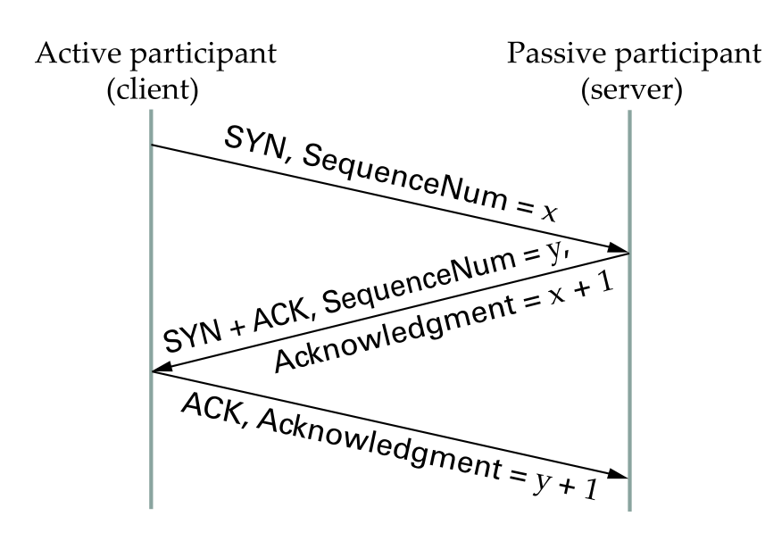
TCP Handshake
First Segment: Client - Sequence number it plans to use (Flags= SYN, SequenceNum= x).
SEcond Segment: Server - 1 segment that both acknowledges the client’s sequence number (Flags= ACK, Ack= x + 1) and states its own beginning sequence number (Flags= SYN, SequenceNum= y).
Third segment: Client - acknowledges the server’s sequence number (Flags= ACK, Ack= y + 1).

Slide 8
Sequence Numbers and Ack Numbers
The acknowledgment number that Host A puts in its segment is the sequence number of the next byte Host A is expecting from Host B.
The sequence number for a segment is therefore the byte-stream number of the first byte in the segment.

Slide 9

TCP sequence numbers, ACKs
Host A
Host B
User types‘C’
Seq=42, ACK=79, data = ‘C’
host ACKs receipt of‘C’, echoes back ‘C’
Seq=79, ACK=43, data = ‘C’
host ACKs receipt of echoed ‘C’
Seq=43, ACK=80
simple telnet scenario
Notes:
The key thing to note here is that the ACK number (43) on the B-to-A segment is one more than the sequence number (42) on the A-to-B segment that triggered that ACK
Similarly, the ACK number (80) on the last A-to-B segment is one more than the sequence number (79) on the B-to-A segment that triggered that ACK

Slide 10
Flow Control
Receiver controls flow by telling sender size of currently available buffer measured in bytes
Window advertisement
Each segment, including data segments, specifies size of window beyond acknowledged byte
Window size may be zero
receiver cannot accept additional data at present
Receiver can send additional acknowledgement later
buffer space becomes available

Slide 11
(RDT) stop-and-wait operation
sender
receiver
first packet bit transmitted, t = 0
first packet bit arrives
RTT
last packet bit arrives, send ACK
ACK arrives, send next
packet, t = RTT + L / R

Slide 12
Performance of (RDT)(stop-and-wait)
U _{sender}: utilization – fraction of time sender busy sending
example: 1 Gbps link, 15 ms prop. delay, 8000 bit packet
time to transmit packet into channel:
L
8000 bits
D_{trans} =
=
=
8 microsecs
R
10⁹ bits/sec
Notes:
if RTT=30 msec, 1KB pkt every 30 msec: 33kB/sec thruput over 1 Gbps link
network protocol limits use of physical resources
Let’s develop a formula for utilization

Slide 13
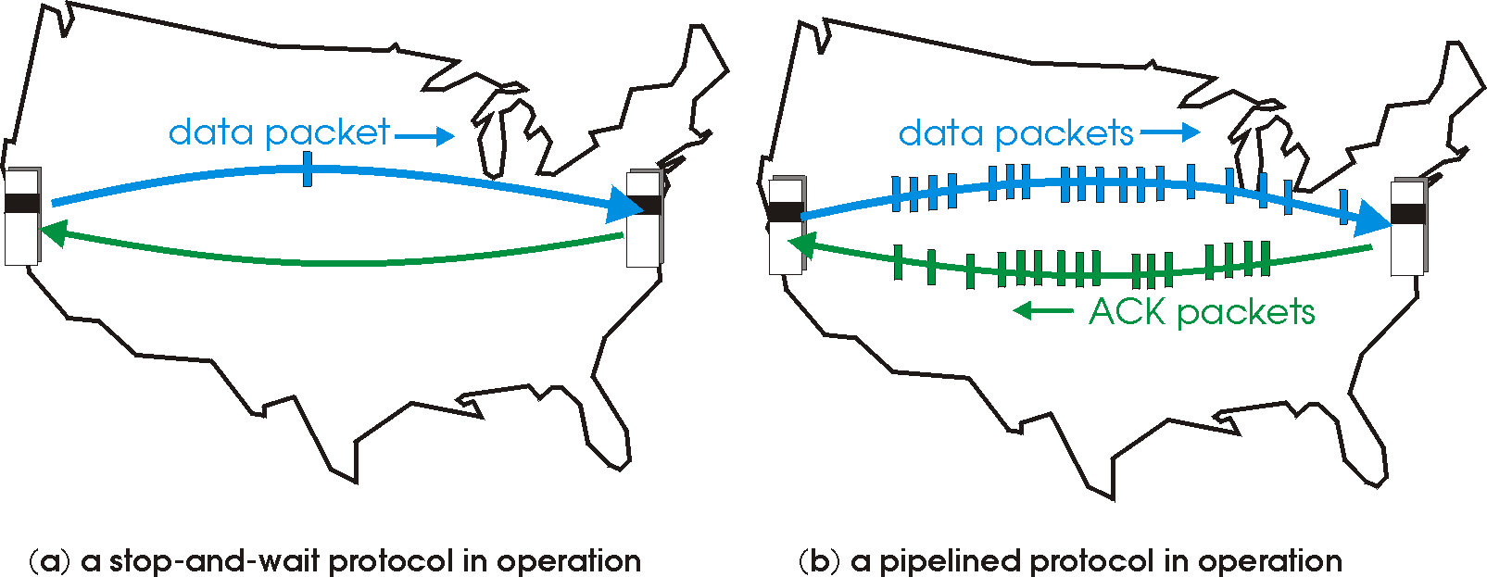
(RDT) pipelined protocols operation
pipelining: sender allows multiple, “in-flight”, yet-to-be-acknowledged packets
range of sequence numbers must be increased
buffering at sender and/or receiver

Slide 14
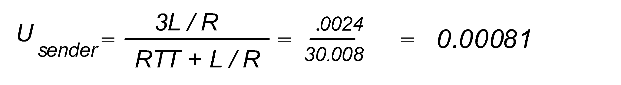
Pipelining: increased utilization
sender
receiver
first packet bit transmitted, t = 0
last bit transmitted, t = L / R
first packet bit arrives
RTT
last packet bit arrives, send ACK
last bit of 2nd packet arrives, send ACK
last bit of 3rd packet arrives, send ACK
ACK arrives, send next
packet, t = RTT + L / R
3-packet pipelining increases
utilization by a factor of 3!
Notes:
two generic forms of pipelined protocols: go-Back-N, selective repeat

Slide 15

Reliable data transfer (RDT) in ACTION
sender
receiver
sender
receiver
send pkt0
pkt0
send pkt0
pkt0
rcv pkt0
rcv pkt0
ack0
send ack0
ack0
send ack0
rcv ack0
rcv ack0
send pkt1
pkt1
send pkt1
pkt1
rcv pkt1
X
ack1
send ack1
loss
rcv ack1
send pkt0
pkt0
rcv pkt0
timeout
resend pkt1
ack0
send ack0
pkt1
rcv pkt1
ack1
send ack1
rcv ack1
send pkt0
pkt0
(a) no loss
rcv pkt0
ack0
send ack0
(b) packet loss

Slide 16
Reliable data transfer (RDT) in ACTION
sender
receiver
sender
receiver
send pkt0
pkt0
rcv pkt0
send pkt0
pkt0
send ack0
rcv pkt0
rcv ack0
ack0
ack0
send ack0
send pkt1
pkt1
rcv ack0
rcv pkt1
send pkt1
pkt1
send ack1
rcv pkt1
ack1
ack1
send ack1
X
timeout
resend pkt1
loss
pkt1
rcv pkt1
timeout
resend pkt1
rcv ack1
(detect duplicate)
pkt1
rcv pkt1
send ack1
send pkt0
pkt0
ack1
(detect duplicate)
rcv pkt0
rcv ack1
send ack1
rcv ack1
ack1
ack0
send ack0
send pkt0
pkt0
(ignore)
rcv pkt0
ack0
send ack0
pkt1
(c) ACK loss
(d) premature timeout/ delayed ACK

Slide 17
An institution has a T1 access line (1.544 Mbps) which services web requests
from about 150 users in the network. The institution is considering putting up a proxy server which
can act as a cache for all these users. (I.e., whenever a user makes a web request, the request is first
sent to the proxy server to see if it can service the request from its cache. Otherwise, the proxy
forwards the requests to the origin server.)
a) The users make on the average 1 request per second, with an average size of
a request object being 10 kbits. What percentage of the bandwidth is consumed by the web traffic
when there is no proxy server, and all requests are serviced by the origin server?
b) After installing the proxy server, it was found that the hit rate to the cache is
40%. What percentage of the institutional bandwidth is now consumed by the Web traffic?

